Slide 1
Tackling Difficult Combinatorial Problems
There are two principal approaches to tackling difficult combinatorial problems (NP-hard problems):
Use a strategy that guarantees solving the problem exactly but doesn’t guarantee to find a solution in polynomial time
Use an approximation algorithm that can find an approximate (sub-optimal) solution in polynomial time

Slide 2
Exact Solution Strategies
exhaustive search (brute force)
  useful only for small instances
dynamic programming
  applicable to some problems (e.g., the knapsack problem)
backtracking
  eliminates some unnecessary cases from consideration
  yields solutions in reasonable time for many instances but worst case is still exponential
branch-and-bound
  further refines the backtracking idea for optimization problems

Slide 3
Backtracking
Construct the state-space tree
  nodes: partial solutions
  edges: choices in extending partial solutions
Explore the state space tree using depth-first search
“Prune” nonpromising nodes
  stop exploring subtrees rooted at nodes that cannot lead to a solution and backtracks to such a node’s parent to continue the search

Slide 4
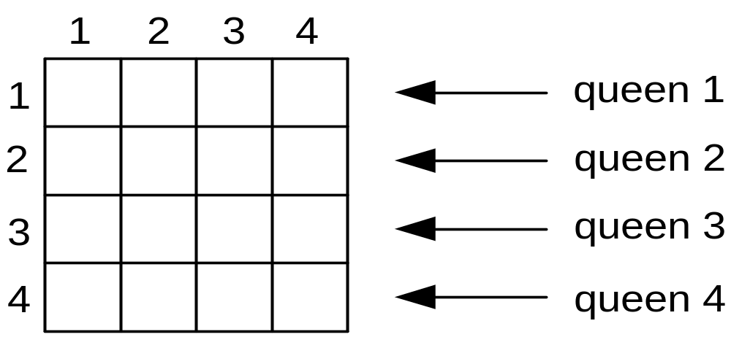
Example: n-Queens Problem
Place n queens on an n-by-n chess board so that no two of them are in the same row, column, or diagonal

Slide 5
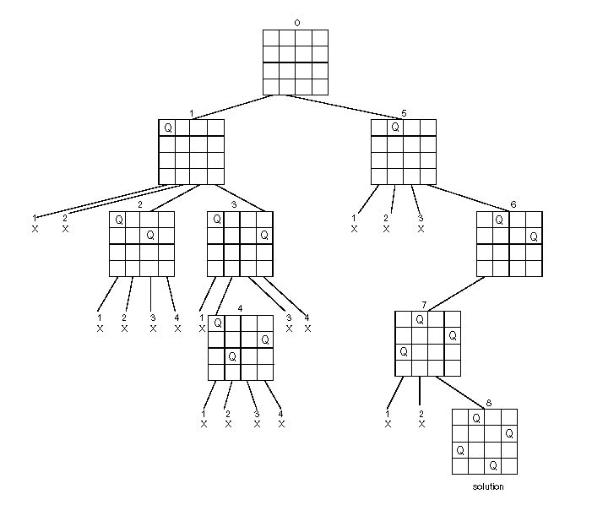
State-Space Tree of the 4-Queens Problem

Slide 6
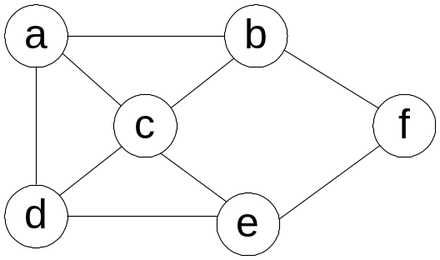
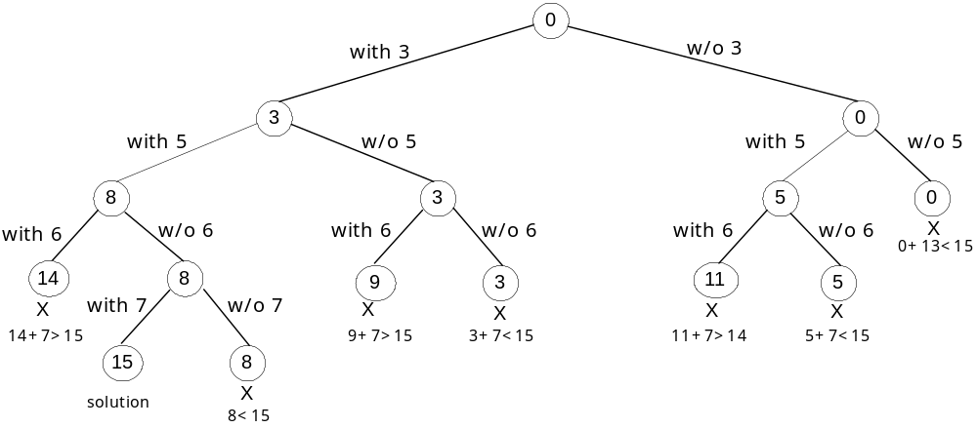
Example: Hamiltonian Circuit Problem

Slide 7
Branch-and-Bound
An enhancement of backtracking
Applicable to optimization problems
For each node (partial solution) of a state-space tree, computes a bound on the value of the objective function for all descendants of the node (extensions of the partial solution)
Uses the bound for:
  ruling out certain nodes as “nonpromising” to prune the tree – if a node’s bound is not better than the best solution seen so far
  guiding the search through state-space

Slide 8
Example: Assignment Problem
Select one element in each row of the cost matrix C so that:
no two selected elements are in the same column
the sum is minimized
Example
Job 1 Job 2 Job 3 Job 4
Person a 9 2 7 8
Person b 6 4 3 7
Person c 5 8 1 8
Person d 7 6 9 4
Lower bound: Any solution to this problem will have total cost
at least: 2 + 3 + 1 + 4 (or 5 + 2 + 1 + 4)

Slide 9
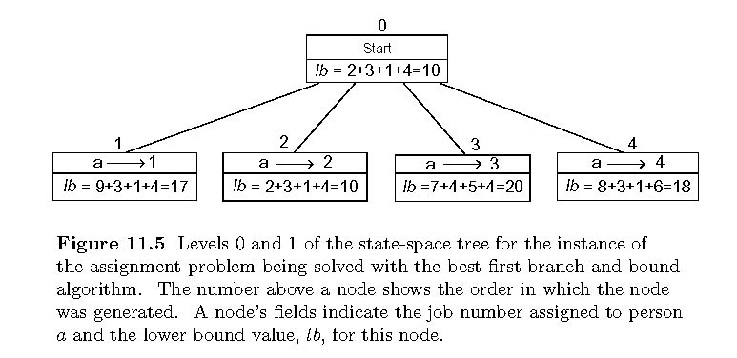
Example: First two levels of the state-space tree
12.5

Slide 10
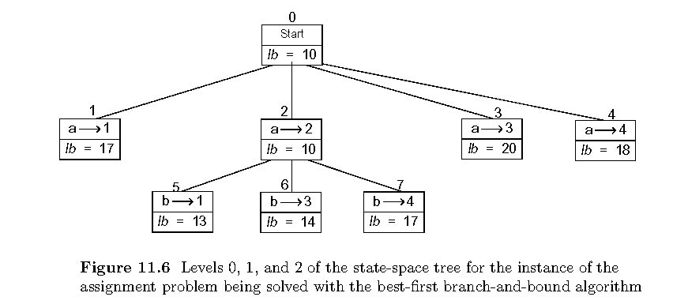
Example (cont.)

Slide 11
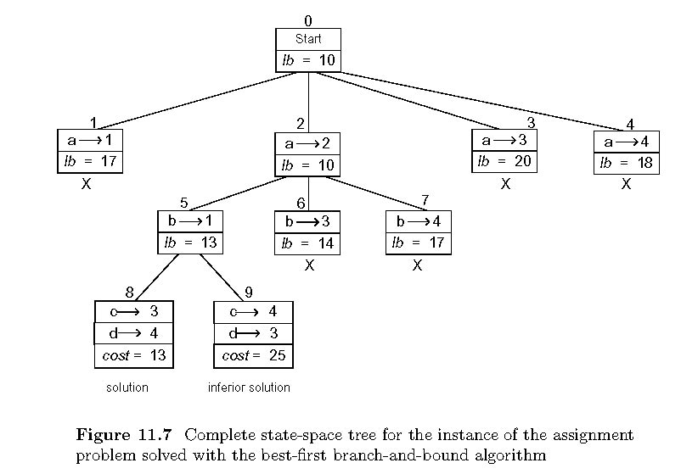
Example: Complete state-space tree

Slide 12
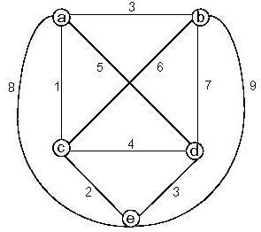
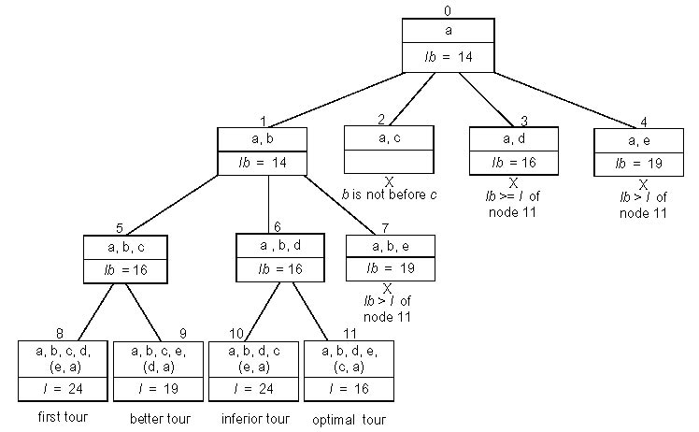
Example: Traveling Salesman Problem

Slide 13
Approximation Approach
Apply a fast (i.e., a polynomial-time) approximation algorithm to get a solution that is not necessarily optimal but hopefully close to it
Accuracy measures:
accuracy ratio of an approximate solution s_{a}
r(s_{a}) = f(s_{a}) / f(s*) for minimization problems
r(s_{a}) = f(s*) / f(s_{a}) for maximization problems
where f(s_{a}) and f(s*) are values of the objective function f for the approximate solution s_{a} and actual optimal solution s*
performance ratio of the algorithm A
the lowest upper bound of r(s_{a}) on all instances

Slide 14
Nearest-Neighbor Algorithm for TSP
Starting at some city, always go to the nearest unvisited city, and, after visiting all the cities, return to the starting one
A B
D C
Note: Nearest-neighbor tour may depend on the starting city
Accuracy: R_{A} = ∞ (unbounded above) – make the length of AD
arbitrarily large in the above example
1
s_{a} : A – B – C – D – A of length 10
s* : A – B – D – C – A of length 8
6
2
3
3
1

Slide 15
Multifragment-Heuristic Algorithm
Stage 1: Sort the edges in nondecreasing order of weights.
Initialize the set of tour edges to be constructed to
empty set
Stage 2: Add next edge on the sorted list to the tour, skipping
those whose addition would’ve created a vertex of
degree 3 or a cycle of length less than n. Repeat
this step until a tour of length n is obtained
Note: R_{A} = ∞, but this algorithm tends to produce better tours
than the nearest-neighbor algorithm

Slide 16
Twice-Around-the-Tree Algorithm
Stage 1: Construct a minimum spanning tree of the graph
(e.g., by Prim’s or Kruskal’s algorithm)
Stage 2: Starting at an arbitrary vertex, create a path that goes
twice around the tree and returns to the same vertex
Stage 3: Create a tour from the circuit constructed in Stage 2 by
making shortcuts to avoid visiting intermediate vertices
more than once
Note: R_{A} = ∞ for general instances, but this algorithm tends to
produce better tours than the nearest-neighbor algorithm

Slide 17
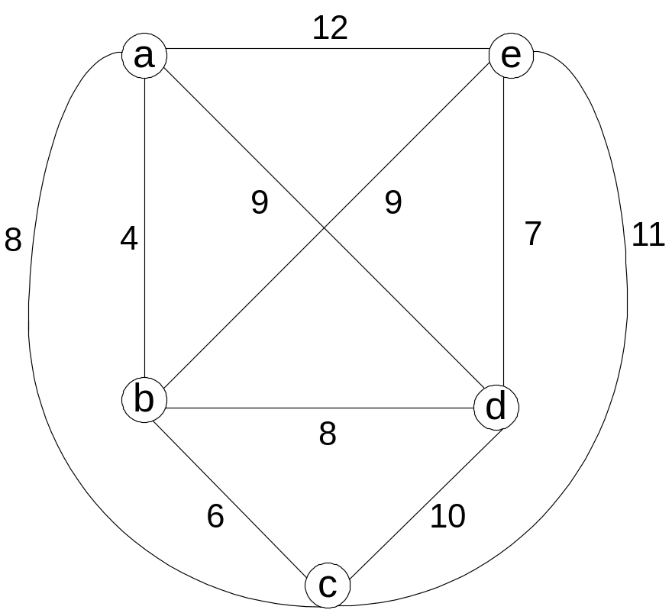
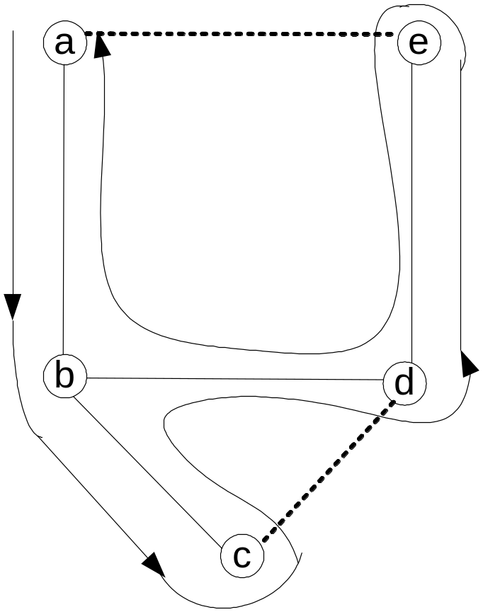
Example
Walk: a – b – c – b – d – e – d – b – a Tour: a – b – c – d – e – a

Slide 18
Christofides Algorithm
Stage 1: Construct a minimum spanning tree of the graph
Stage 2: Add edges of a minimum-weight matching of all the odd
vertices in the minimum spanning tree
Stage 3: Find an Eulerian circuit of the multigraph obtained in
Stage 2
Stage 3: Create a tour from the path constructed in Stage 2 by
making shortcuts to avoid visiting intermediate vertices
more than once
R_{A} = ∞ for general instances, but it tends to produce better
tours than the twice-around-the-minimum-tree alg.

Slide 19
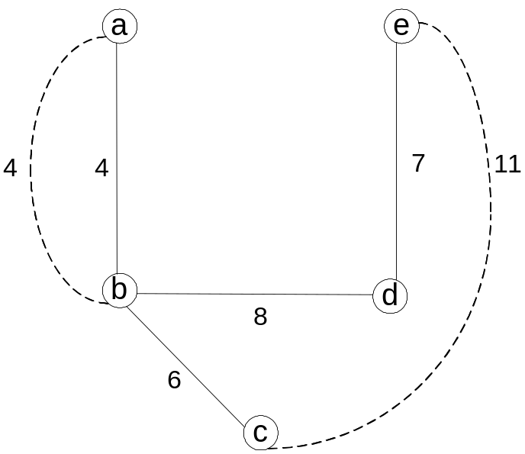
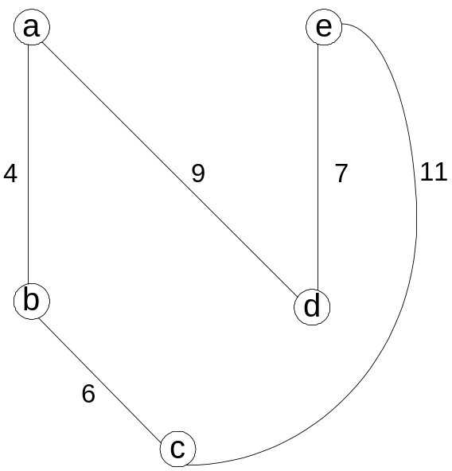
Example: Christofides Algorithm

Slide 20
Euclidean Instances
Theorem If P ≠ NP, there exists no approximation algorithm
for TSP with a finite performance ratio.
Definition An instance of TSP is called Euclidean, if its
distances satisfy two conditions:
1. symmetry d[i, j] = d[j, i] for any pair of cities i and j
2. triangle inequality d[i, j] ≤ d[i, k] + d[k, j] for any cities i, j, k
For Euclidean instances:
approx. tour length / optimal tour length ≤ 0.5(⌈log₂ n⌉ + 1)
for nearest neighbor and multifragment heuristic;
approx. tour length / optimal tour length ≤ 2
for twice-around-the-tree;
approx. tour length / optimal tour length ≤ 1.5
for Christofides

Slide 21
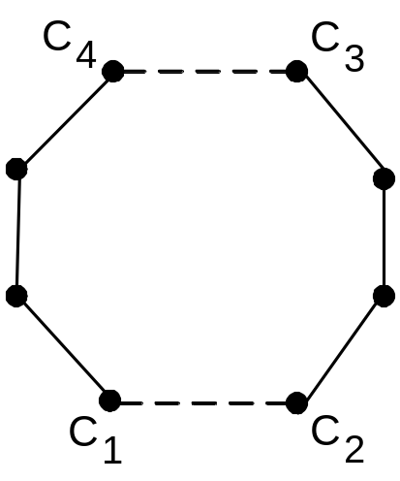
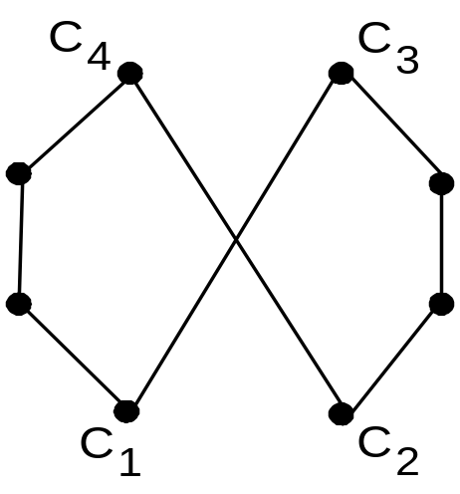
Local Search Heuristics for TSP
Start with some initial tour (e.g., nearest neighbor). On each iteration, explore the current tour’s neighborhood by exchanging a few edges in it. If the new tour is shorter, make it the current tour; otherwise consider another edge change. If no change yields a shorter tour, the current tour is returned as the output.
Example of a 2-change

Slide 22
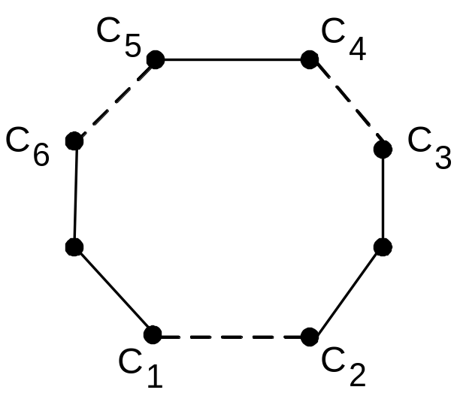
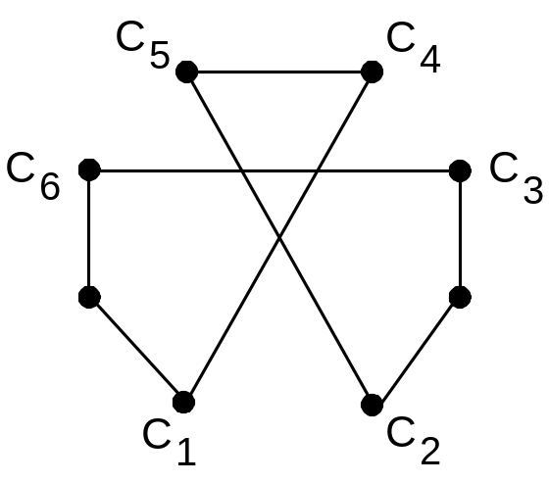
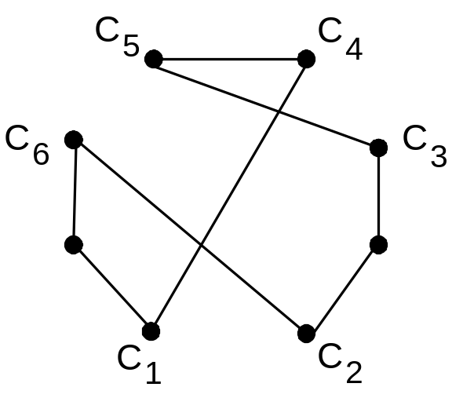
Example of a 3-change

Slide 23
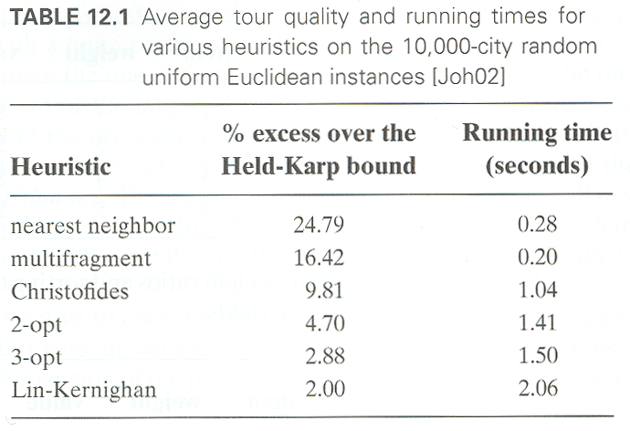
Empirical Data for Euclidean Instances

Slide 24
Greedy Algorithm for Knapsack Problem
Step 1: Order the items in decreasing order of relative values:
v₁/w₁ ≥ ⋯ ≥ v_{n}/w_{n}
Step 2: Select the items in this order skipping those that don’t
fit into the knapsack
Example: The knapsack’s capacity is 16
item weight value v/w
1 2 $40 20
2 5 $30 6
3 10 $50 5
4 5 $10 2
Accuracy
R_{A} is unbounded (e.g., n = 2, C = m, w₁=1, v₁=2, w₂=m, v₂=m)
yields exact solutions for the continuous version

Slide 25
Approximation Scheme for Knapsack Problem
Step 1: Order the items in decreasing order of relative values:
v₁/w₁ ≥ ⋯ ≥ v_{n}/w_{n}
Step 2: For a given integer parameter k, 0 ≤ k ≤ n, generate all
subsets of k items or less and for each of those that fit the
knapsack, add the remaining items in decreasing
order of their value to weight ratios
Step 3: Find the most valuable subset among the subsets generated in Step 2 and return it as the algorithm’s output
Accuracy: f(s*) / f(s_{a}) ≤ 1 + 1/k for any instance of size n
Time efficiency: O(kn^{k+1})
There are fully polynomial schemes: algorithms with polynomial running time as functions of both n and k

Slide 26
Bin Packing Problem: First-Fit Algorithm
First-Fit (FF) Algorithm: Consider the items in the order given and place each item in the first available bin with enough room for it; if there are no such bins, start a new one
Example: n = 4, s₁ = 0.4, s₂ = 0.2, s₃ = 0.6, s₄ = 0.7
Accuracy
Number of extra bins never exceeds optimal by more than
70% (i.e., R_{A} ≤ 1.7)
Empirical average-case behavior is much better. (In one
experiment with 128,000 bins, the relative error was found
to be no more than 2%.)

Slide 27
Bin Packing: First-Fit Decreasing Algorithm
First-Fit Decreasing (FFD) Algorithm: Sort the items in decreasing order (i.e., from the largest to the smallest). Then proceed as above by placing an item in the first bin in which it fits and starting a new bin if there are no such bins
Example: n = 4, s₁ = 0.4, s₂ = 0.2, s₃ = 0.6, s₄ = 0.7
Accuracy
Number of extra bins never exceeds optimal by more than
50% (i.e., R_{A} ≤ 1.5)
Empirical average-case behavior is much better, too

Slide 28
Numerical Algorithms
Numerical algorithms concern with solving mathematical problems such as
evaluating functions (e.g., √x, e^{x}, ln x, sin x)
solving nonlinear equations
finding extrema of functions
computing definite integrals
Most such problems are of “continuous” nature and can be solved only approximately

Slide 29
Principal Accuracy Metrics
Absolute error of approximation (of α* by α )
|α - α*|
Relative error of approximation (of α* by α )
|α - α*| / |α*|
  undefined for α* = 0
  often quoted in %

Slide 30
Two Types of Errors
truncation errors
  Taylor’s polynomial approximation
  e^{x} ≈ 1 + x + x²/2! + ⋯ + x^{n}/n!
  absolute error ≤ M |x|^{n+1}/(n+1)! where M = max e^{t} for 0 ≤ t ≤ x
  composite trapezoidal rule
  ∫ f(x)dx ≈ (h/2) [f(a) + 2Σ_{1≤=i ≤=n-1} f(x_{i}) + f(b)], h = (b - a)/n
  absolute error ≤ (b-a)h² M₂ / 12 where M₂ = max |f′′(x)| for a ≤x ≤ b
round-off errors
b
a

Slide 31
Solving Quadratic Equation
Quadratic equation ax² + bx + c = 0 (a≠ 0)
x_{1,2} = (-b ± √D)/2a where D = b² - 4ac
Problems:
computing square root
use Newton’s method: x_{n+1} = 0.5(x_{n} + D/x_{n})
subtractive cancellation
use alternative formulas (see p. 411)
use double precision for D = b² - 4ac
other problems (overflow, etc.)

Slide 32
Notes on Solving Nonlinear Equations
There exist no formulas with arithmetic ops. and root extractions for roots of polynomials
a_{n}x^{n} + a_{n-1}x^{n-1} + ⋯ + a₀ = 0 of degree n≥ 5
Although there exist special methods for approximating roots of polynomials, one can also use general methods for
f(x) = 0
Nonlinear equation f(x) = 0 can have one, many, infinitely many, and no roots at all
Useful:
  sketch graph of f(x)
  separate roots

Slide 33
Three Classic Methods
Three classic methods for solving nonlinear equation
f(x) = 0
in one unknown:
bisection method
method of false position (regula falsi)
Newton’s method

Slide 34
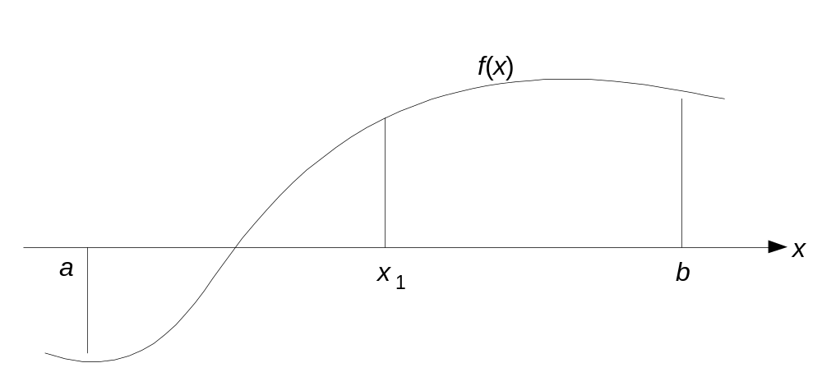
Bisection Method
Based on
Theorem: If f(x) is continuous on a≤x≤ b and f(a) and f(b) have opposite signs, then f(x) = 0 has a root on a < x < b
binary search idea
Approximations x_{n} are middle points of shrinking segments
|x_{n} - x*| ≤ (b - a)/2^{n}
x_{n} always converges to root x* but slower compared to others

Slide 35
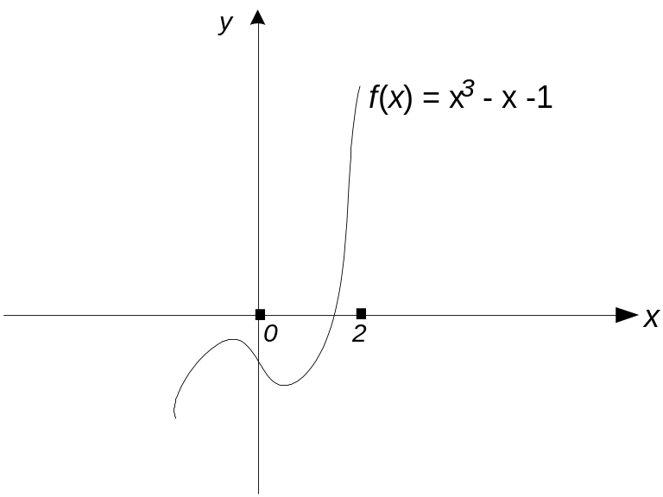
Example of Bisection Method Application
Find the root of
x³ - x - 1=0
with the absolute error not larger than 0.01
n | a_{n} | b_{n} | x_{n} | f(x_{n})
1 | 0.0- | 2.0+ | 1.0 | -1.0
2 | 1.0- | 2.0+ | 1.5 | 0.875
3 | 1.0- | 1.5+ | 1.25 | -0.296875
4
5
6
7
8 | 1.3125- | 1.328125+ | 1.3203125 | -0.018711
x ≈ 1.3203125

Slide 36
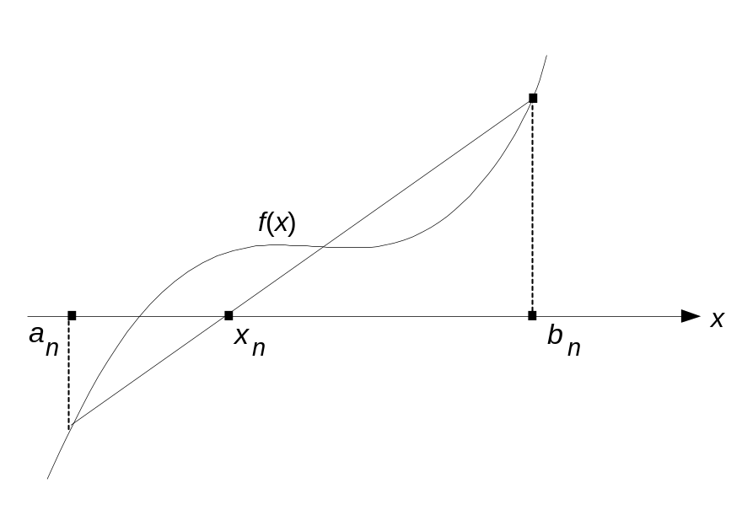
Method of False Position
Similar to bisection method but uses x-intercept of line through
(a, f(a)) and (b, f(b)) instead of middle point of [a,b]
Approximations x_{n} are computed by the formula
x_{n} = [a_{n}f(b_{n}) - b_{n}f(a_{n})] / [f(b_{n}) - f(a_{n})]
Normally x_{n} converges faster than bisection method sequence but slower than Newton’s method sequence

Slide 37
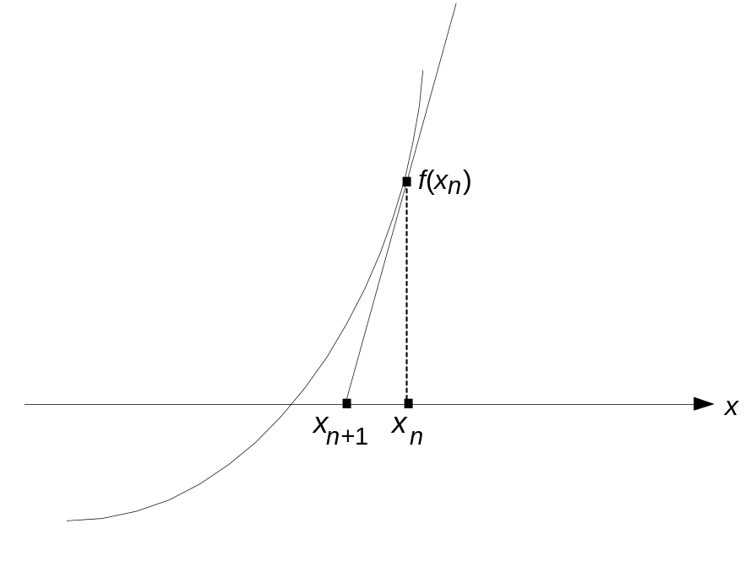
Newton’s Method
Very fast method in which x_{n}’s are x-intercepts of tangent lines
to the graph of f(x)
Approximations x_{n} are computed by the formula
x_{n+1} = x_{n} - f(x_{n}) / f′(x_{n})

Slide 38
Notes on Newton’s Method
Normally, approximations x_{n} converge to root very fast but can diverge with a bad choice of initial approximation x₀
Yields a very fast method for computing square roots
x_{n+1} = 0.5(x_{n} + D/x_{n})
Can be generalized to much more general equations

